Slide 1



Slide 2






Challenges of Payroll Processing Faced by Organizations
Higher Costs
Compliance
Accuracy
Safety and Security
Tax related Issues
Burden on Finance Team

Slide 3
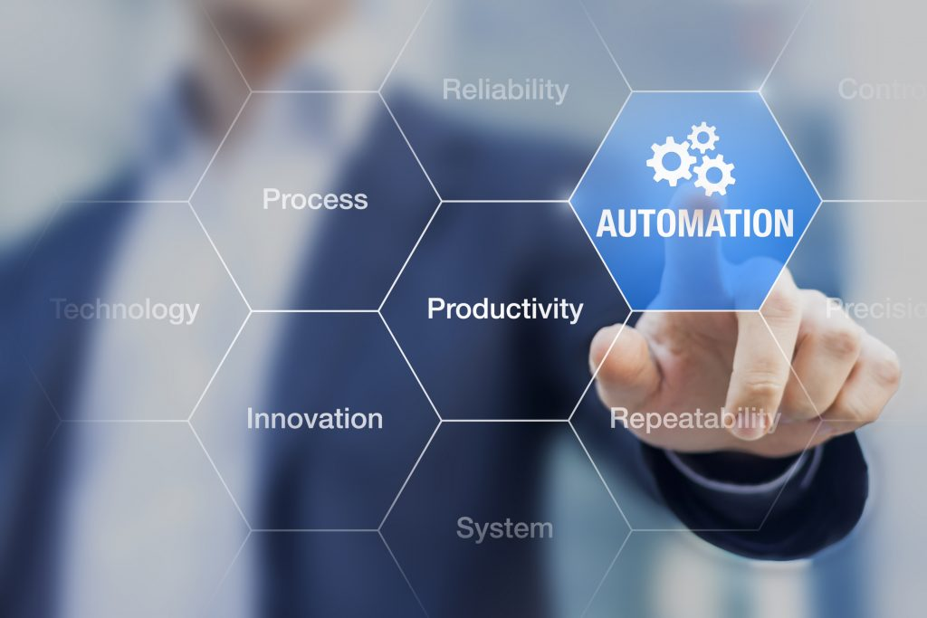
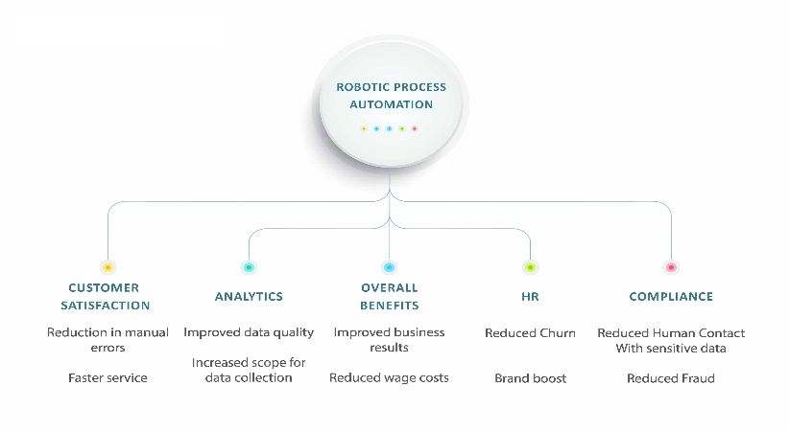
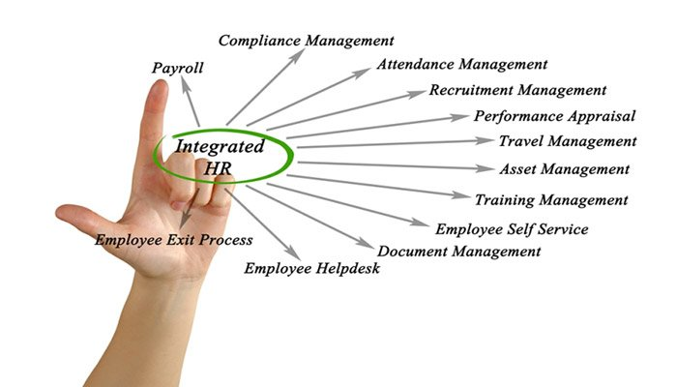
Technology Assist Process Automation
IT Industries – Transformation
RPA - HR, Finance, Accounts,
Integrated HR

Slide 4
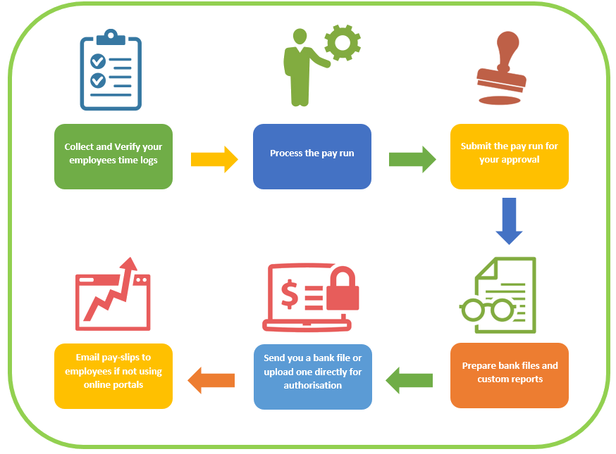

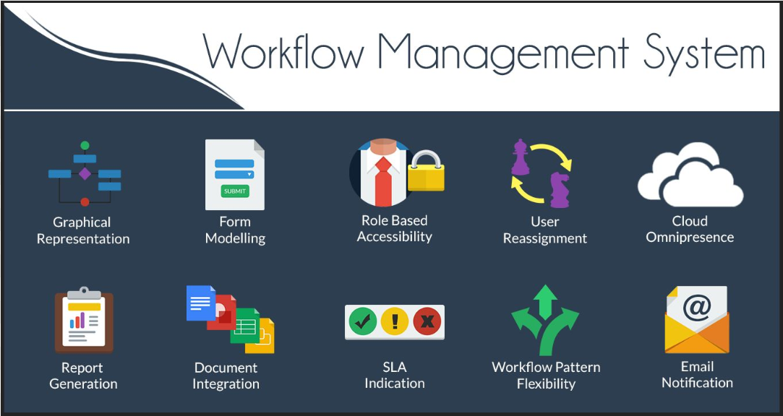
Payroll Automation
Payroll function requires repetitive processing of payroll taking into company rules
Absence Management - Personnel can be genuinely confused about or unaware of the absence management system -Bot
Data Management - HR departments routinely get requests on personnel data which is constantly changing - Bot

Slide 5
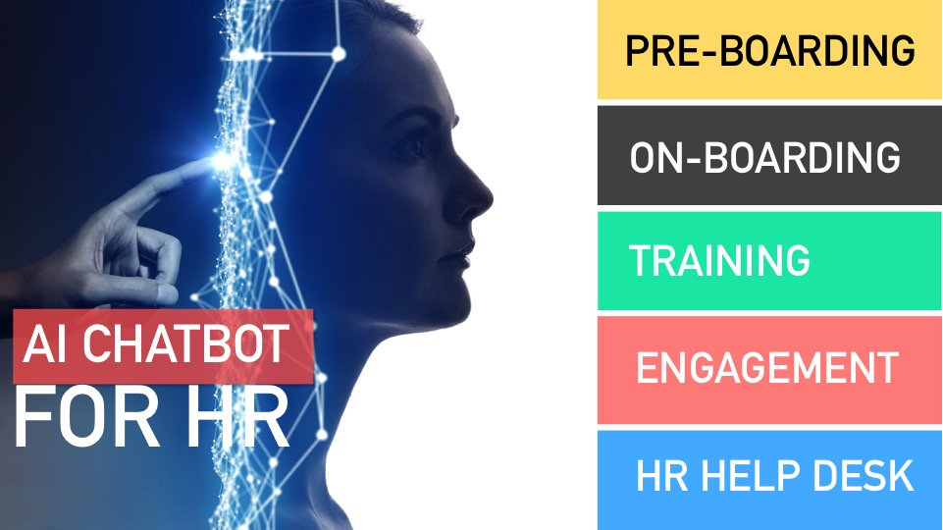
Technology Assist Process Automation

Slide 6

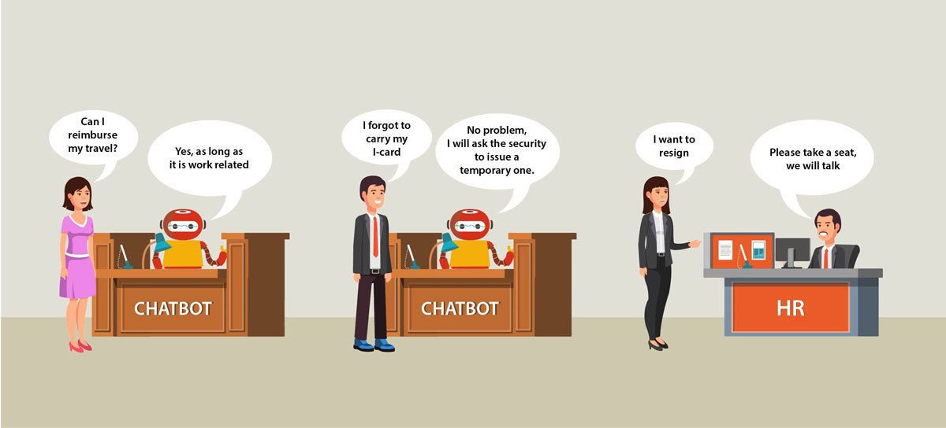
Integrated Personal Department

Slide 7
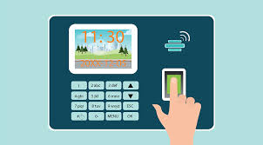



Employee / User Login
Different types of Logins
Login using Biometric Device
Login using Swipe Card
Login using Badge
Login using Face Recognition

Slide 8
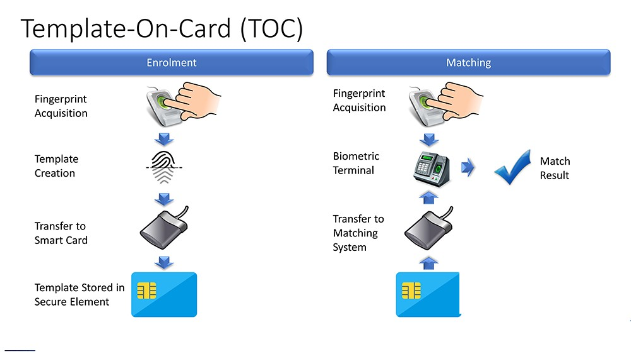
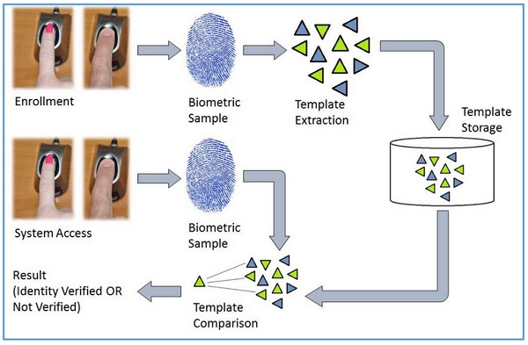
Creating Biometric Template
Biometric Sample Acquisition
Template Extraction
Storage to DB / Mem Card
Access
Template Comparison
Result verified / Not Verified

Slide 9
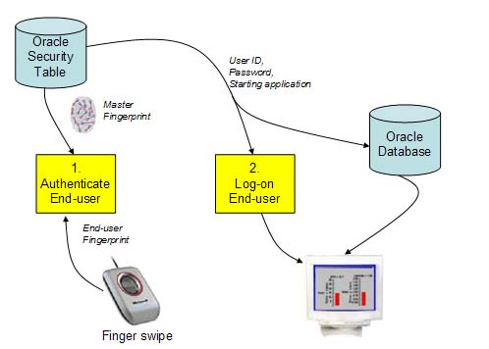
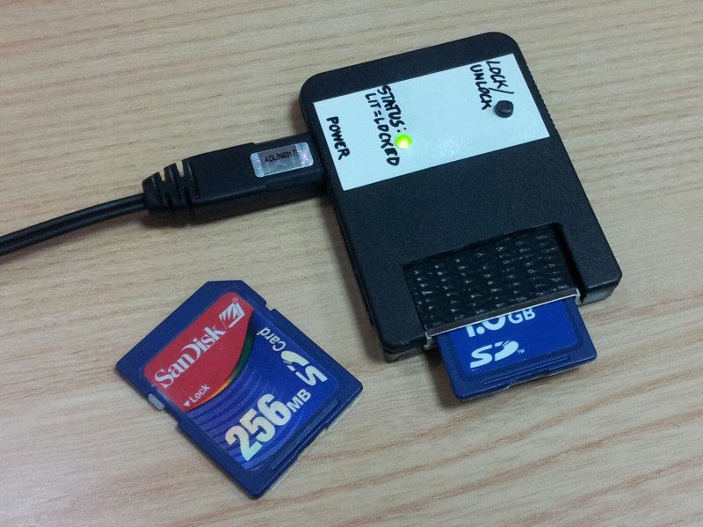
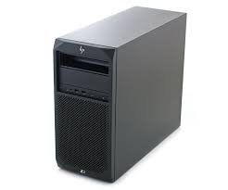
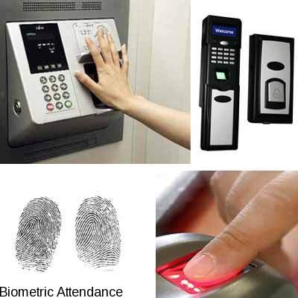
Storage Options
Data Base
Token / Memory card
Individual workstation
Sensing Device

Slide 10
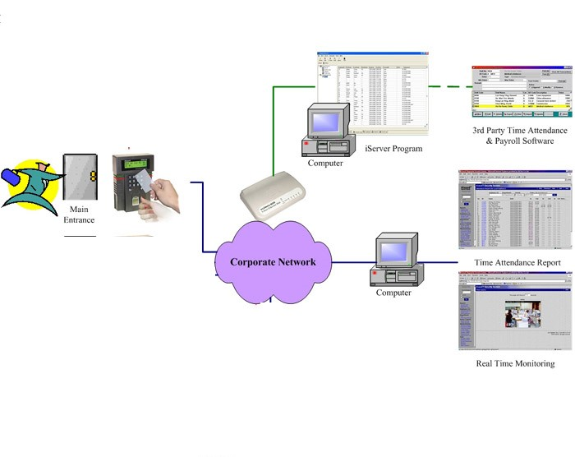
Architecture

Slide 11
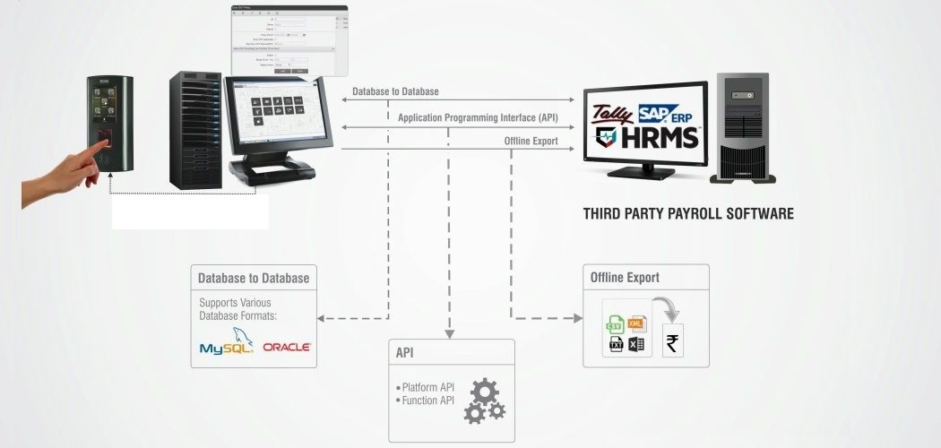
This type solution provides three types of integration, which are as listed below:
Types Of Integration

Slide 12
Benefits of Software Integration
Accurate Attendance Data Transfer to Payroll Software
Smooth and Quick Payroll Processing
Minimized Human Intervention
Reduced Time Spent on Payroll Processing
Reduced Erroneous Payroll
Timely Salary Payments
Increase in Overall Productivity

Slide 13
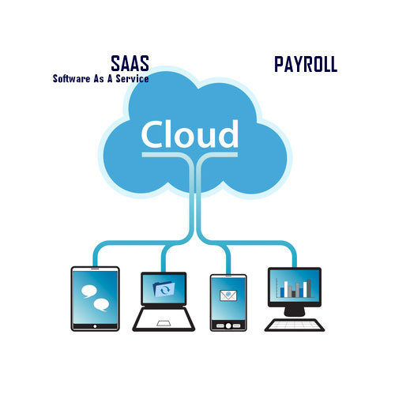
SaaS Model Solutions & Benefits
SaaS can be used to manage many different business technologies. Human resources is one of the main areas
Subscribes to a SaaS solution, the users access the software through the internet using login codes. The provider hosts the solution, running the application on their own servers.
Provider maintains the solution and makes sure that it remains secure. Providers are responsible for updating the system, continuously managing security, patching glitches, and providing support as needed for clients. Clients simply use the system for their needs and contact the provider as needed to rectify any issues.
SaaS solutions often integrate easily with existing solutions. There is no need for extraneous hardware – saving the expense, space, and time that would be needed to host an on-premise solution.

Slide 14
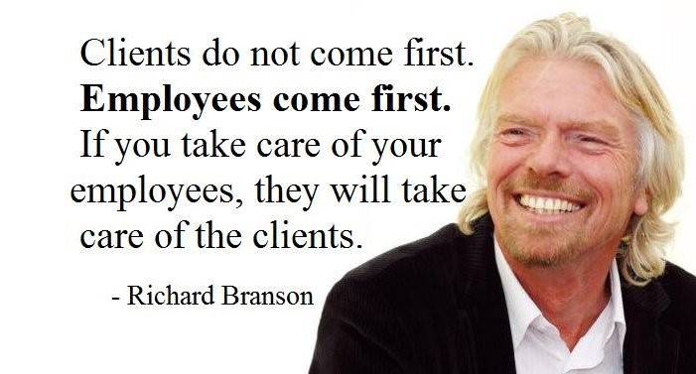
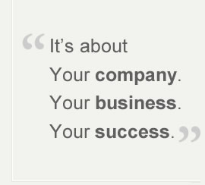
LET YOUR EMPLOYEES SMILE THEMSELF

